Slide 1
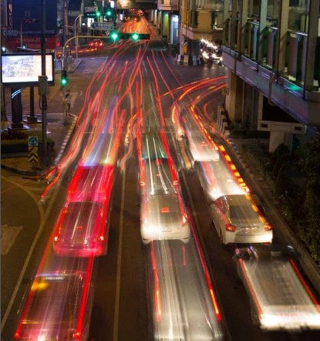
INTERNET OF THINGS & ITS APPLICATIONS
Mrs K Bhavana
Asst Prof/ECE

Slide 2
OBJECTIVES
To study the fundamentals about IoT
To study about IoT Access technologies
To study the design methodology and different IoT hardware platforms.
To study the basics of IoT Data Analytics and supporting services.
To study about various IoT case studies and industrial applications.

Slide 3
Outcomes
Understand the basics of IoT.
Implement the state of the Architecture of an IoT.
Understand design methodology and hardware platforms involved in IoT.
Understand how to analyze and organize the data.
Compare IOT Applications in Industrial & real world.

Slide 4
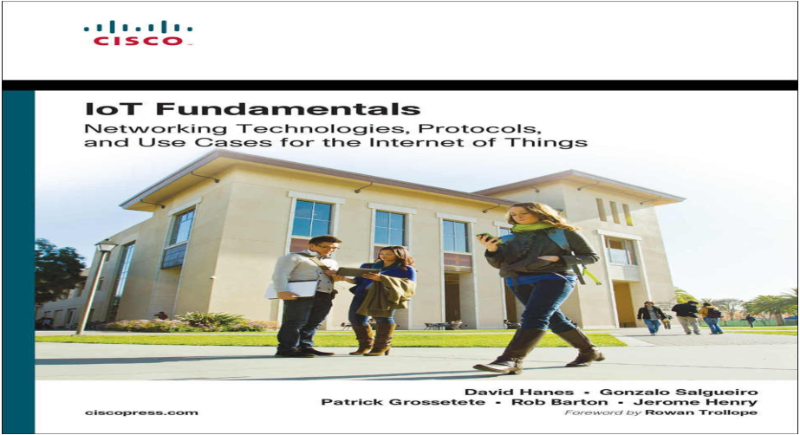
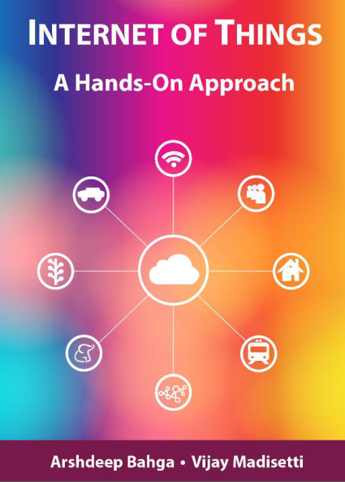
Text Books

Slide 5
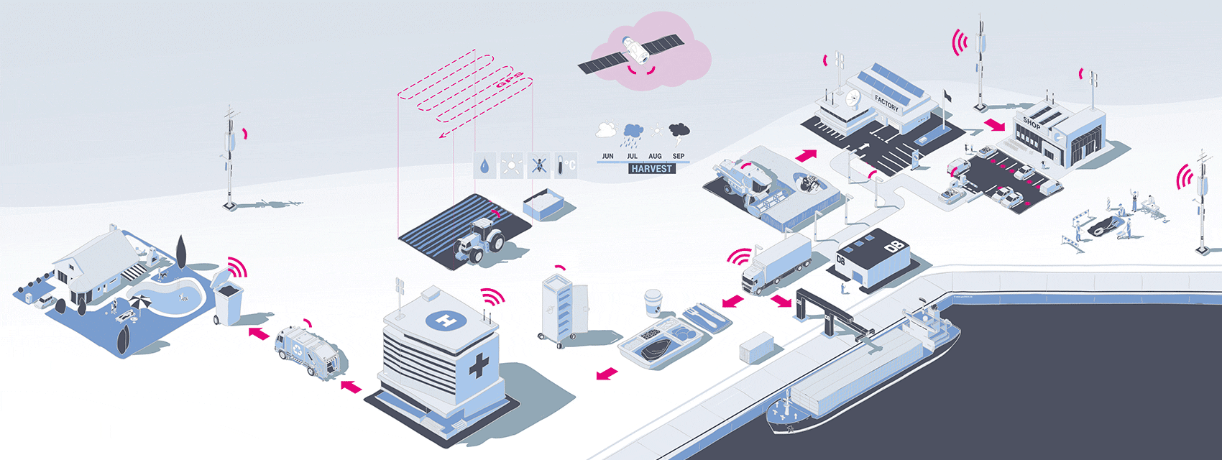
UNIT I: FUNDAMENTALS OF IoT
Evolution of Internet of Things, Enabling Technologies
M2M Communication
IoT World Forum (IoTWF) standardized architecture,
Simplified IoT Architecture
Core IoT Functional Stack, Fog, Edge and Cloud in IoT
Functional blocks of an IoT ecosystem, Sensors, Actuators, Smart Objects and Connecting Smart Objects.

Slide 6
Things
Things are objects of the physical world (physical things) or of the information world (virtual world) which are capable of being identified and integrated into communication networks. Things have associated information, which can be static and dynamic.
Physical things exist in the physical world and are capable of being sensed, actuated and connected. Examples of physical things include the surrounding environment, industrial robots, goods and electrical equipment.
Virtual things exist in the information world and are capable of being stored, processed and accessed. Examples of virtual things include multimedia content and application software.

Slide 7
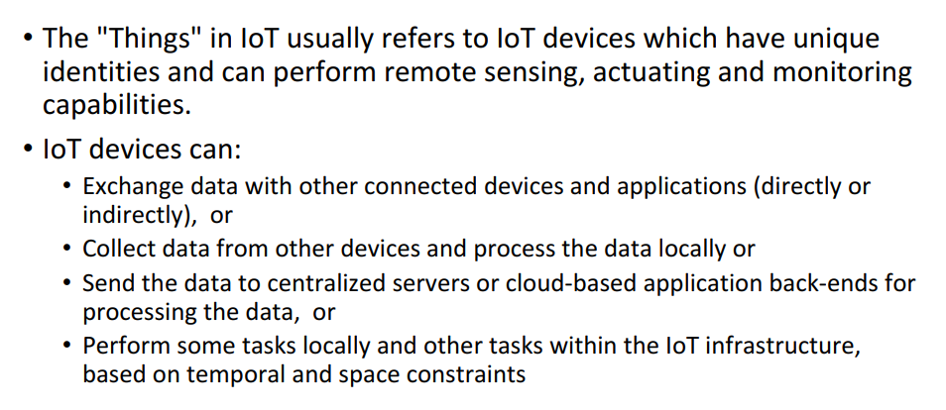
Contd..

Slide 8
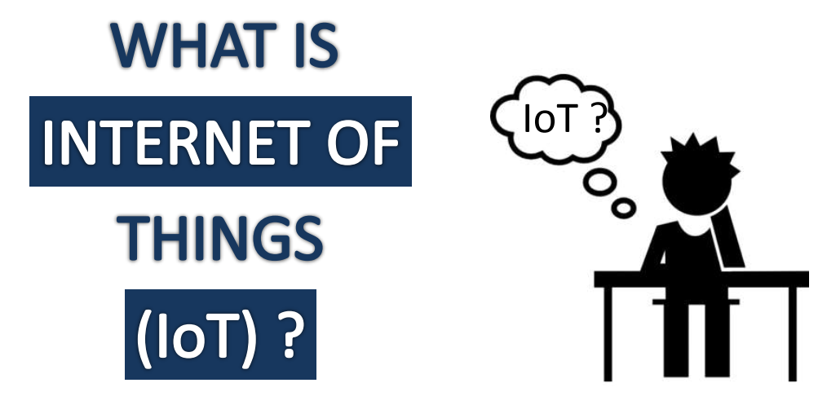
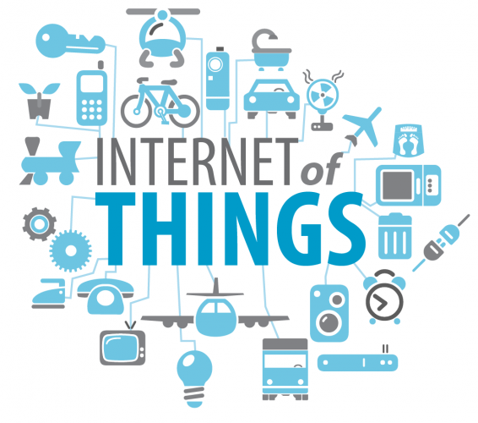

Slide 9
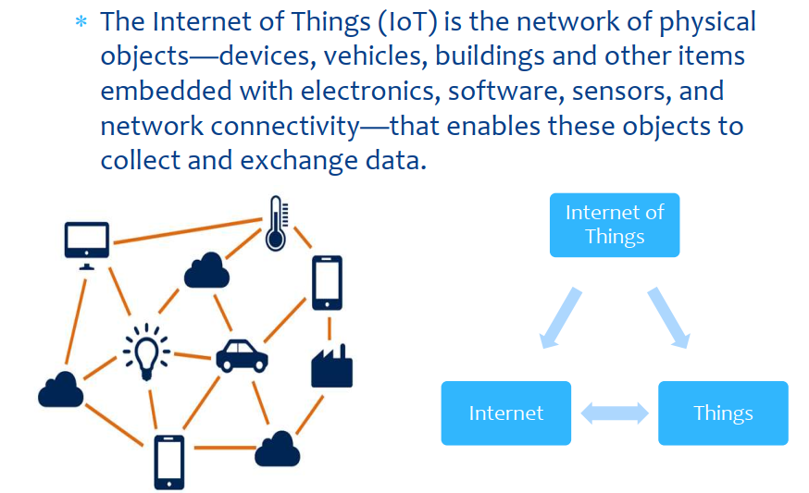
Internet of Things(IoT)

Slide 10
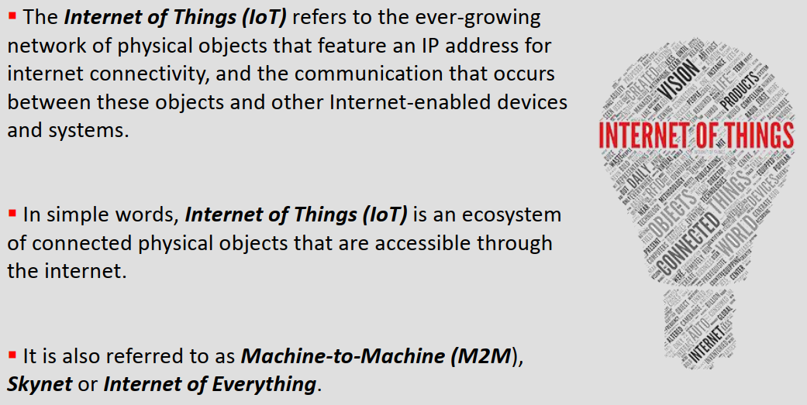
Contd..

Slide 11
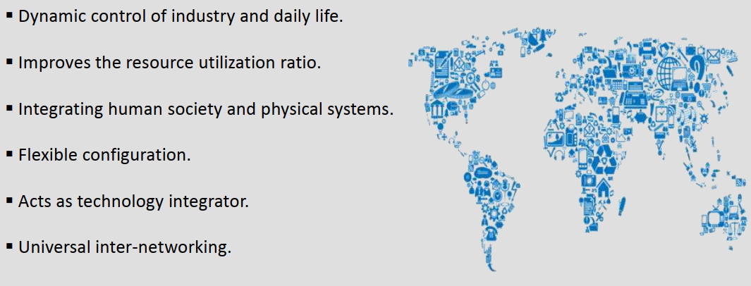
Why IoT ?

Slide 12





IOT: People connecting with Things
ECG sensor
Internet
Motion sensor
Motion sensor
Motion sensor

Slide 13
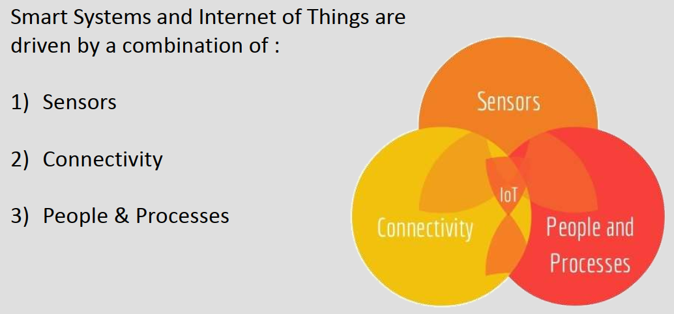
Components of IoT

Slide 14
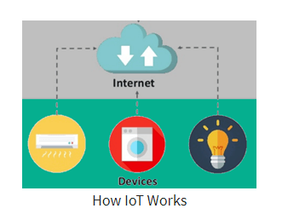
How IoT works?

Slide 15
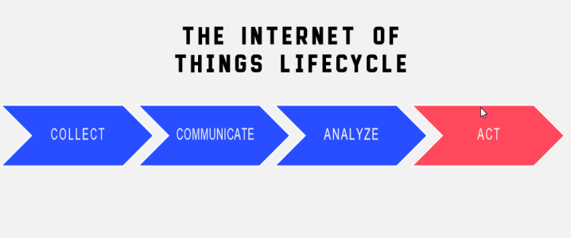
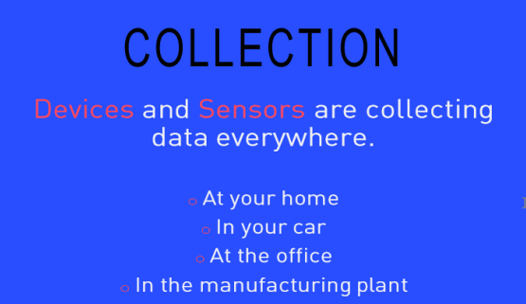
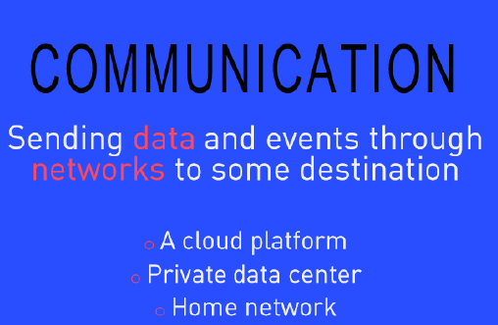

Slide 16
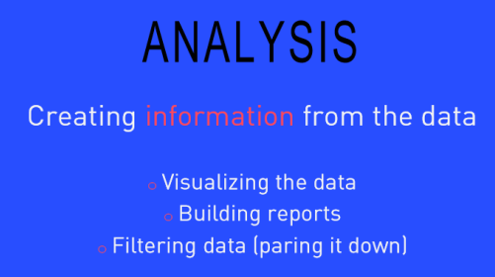
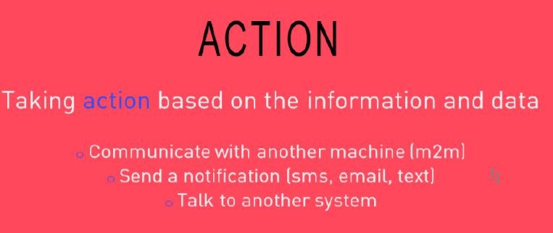

Slide 17
History of IoT
1970- The actual idea of connected devices was proposed
1990- John Romkey created a toaster which could be turned on/off over the Internet
1995- Siemens introduced the first cellular module built for M2M
1999- The term "Internet of Things" was used by Kevin Ashton during his work at P&G which became widely accepted
2004 - The term was mentioned in famous publications like the Guardian, Boston Globe, and Scientific American
2005-UN's International Telecommunications Union (ITU) published its first report on this topic.
2008- The Internet of Things was born
2011- Gartner, the market research company, include "The Internet of Things" technology in their research

Slide 18
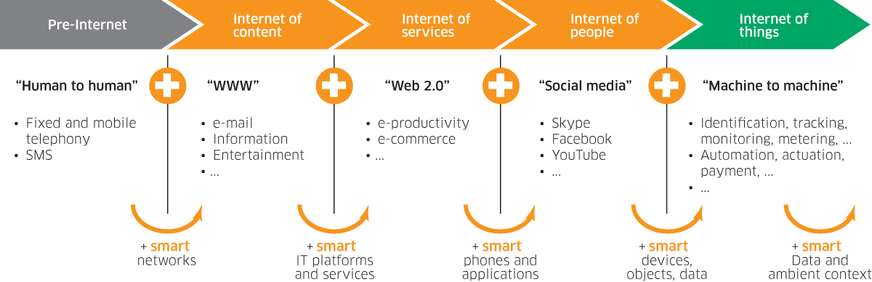
Internet of Things - Evolution

Slide 19
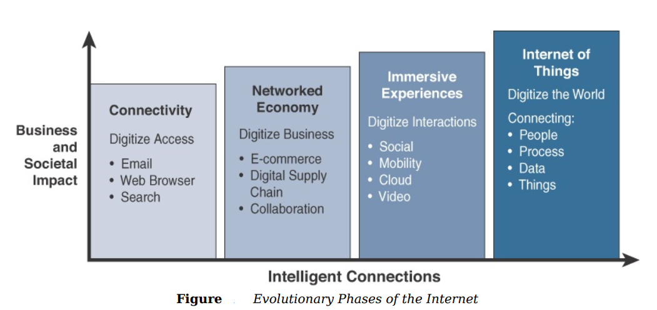

Slide 20
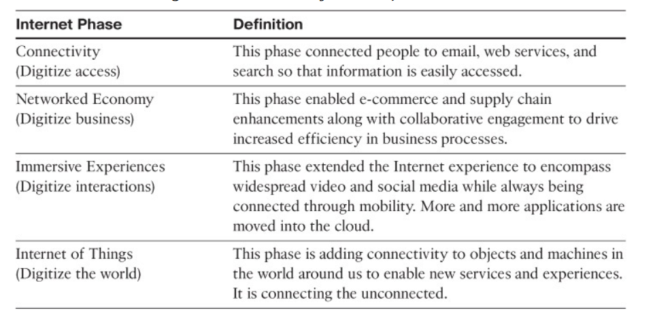

Slide 21
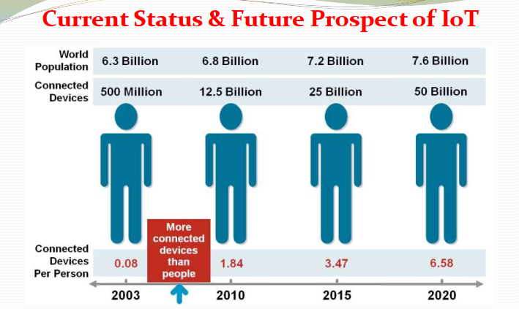

Slide 22
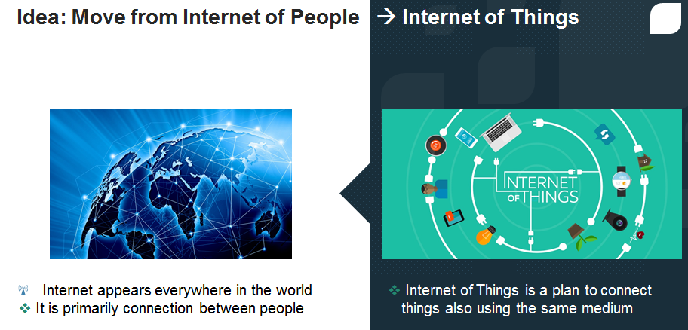

Slide 23
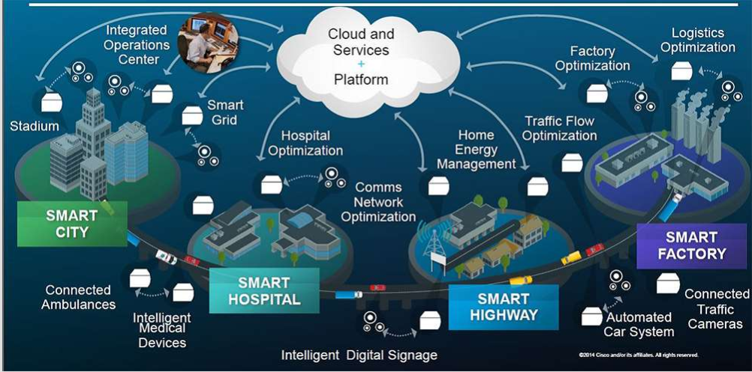
A Gateway to the future!

Slide 24
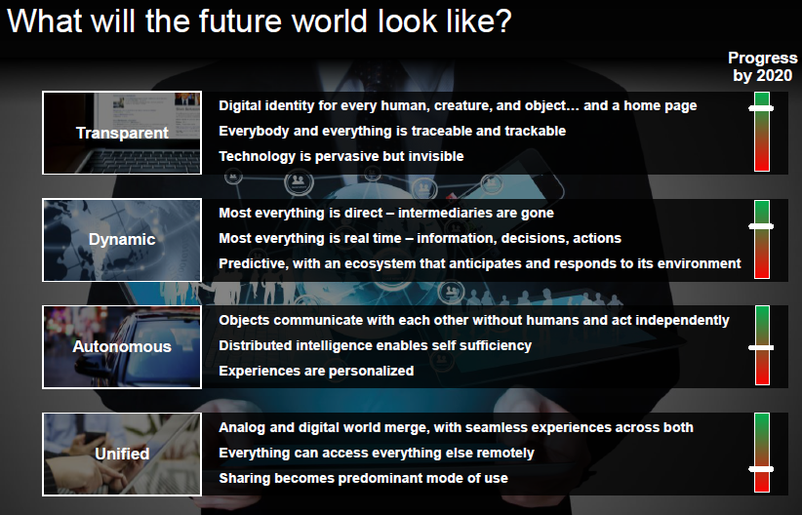

Slide 25
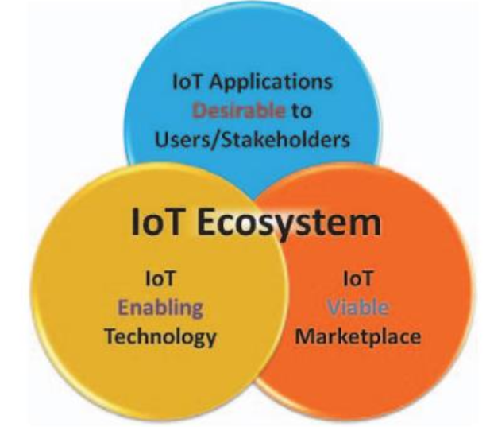
IoT Ecosystem

Slide 26
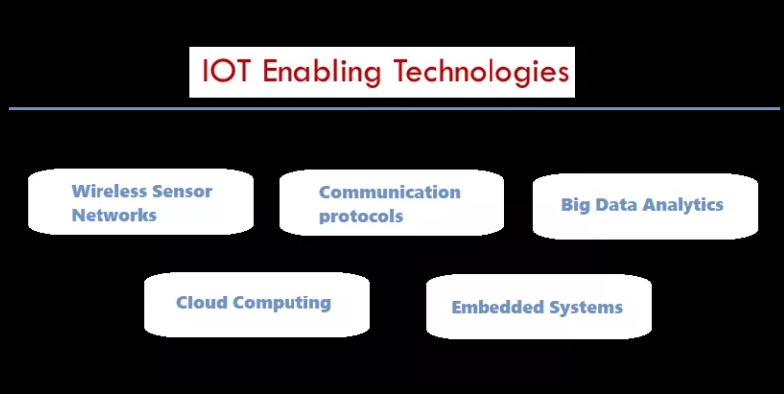

Slide 27
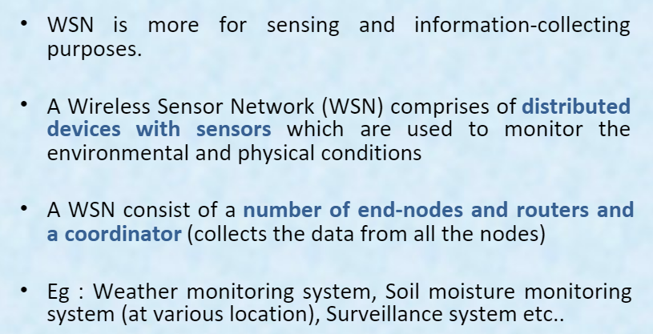
Wireless Sensor Networks

Slide 28
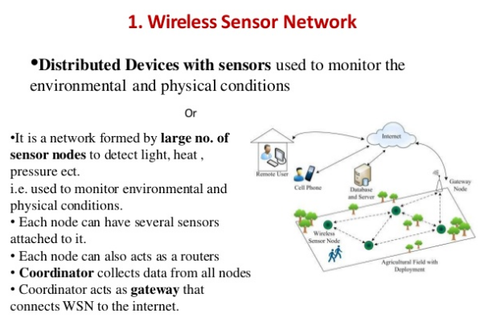

Slide 29
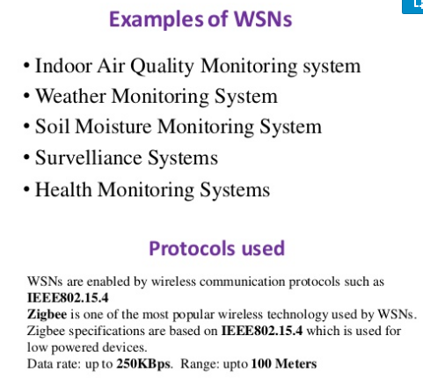

Slide 30
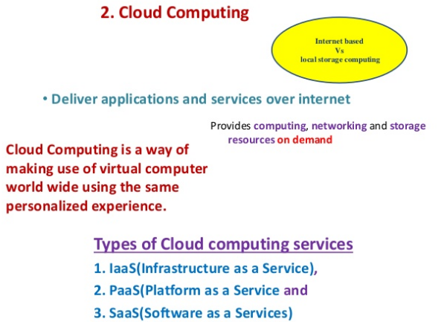

Slide 31
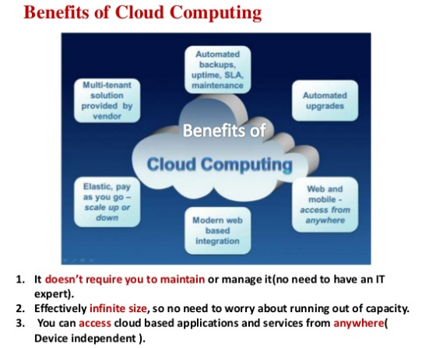

Slide 32
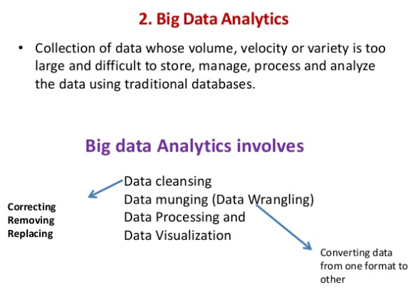

Slide 33
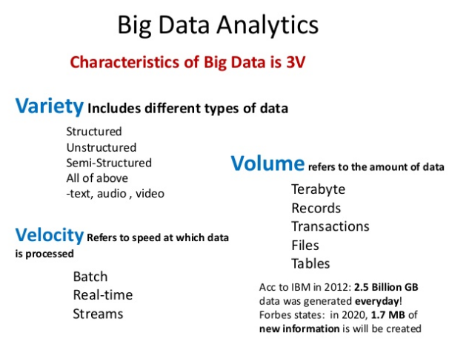

Slide 34
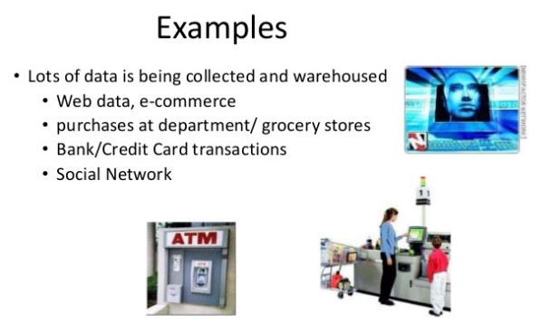

Slide 35
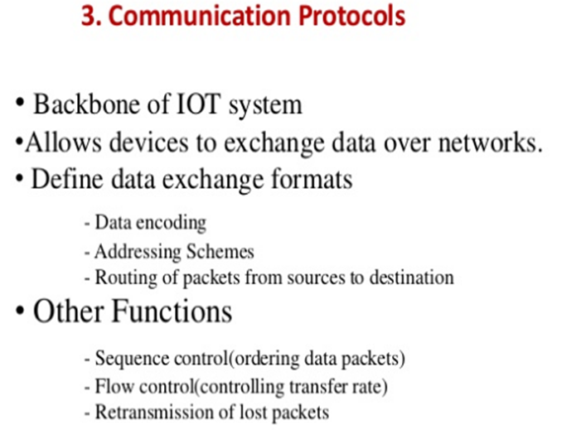

Slide 36
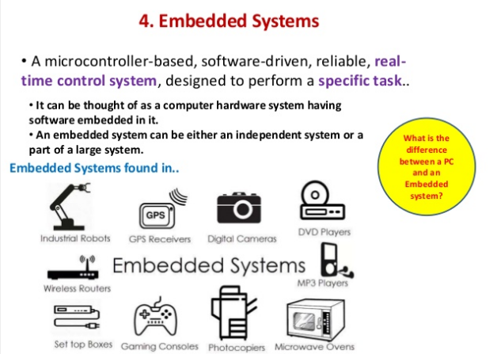

Slide 37
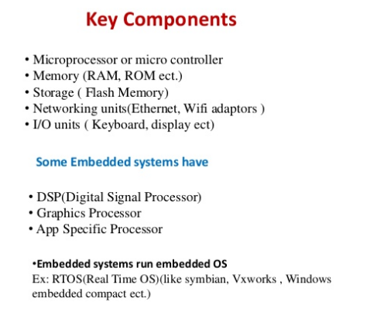

Slide 38
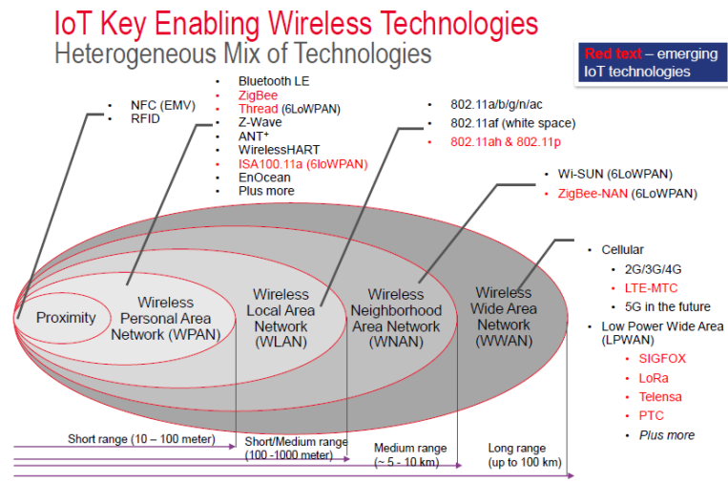

Slide 39
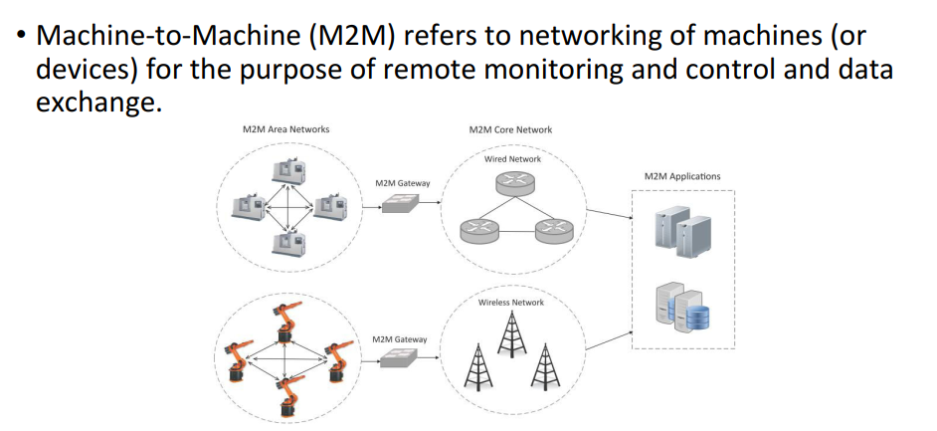
Machine-to-Machine (M2M)

Slide 40
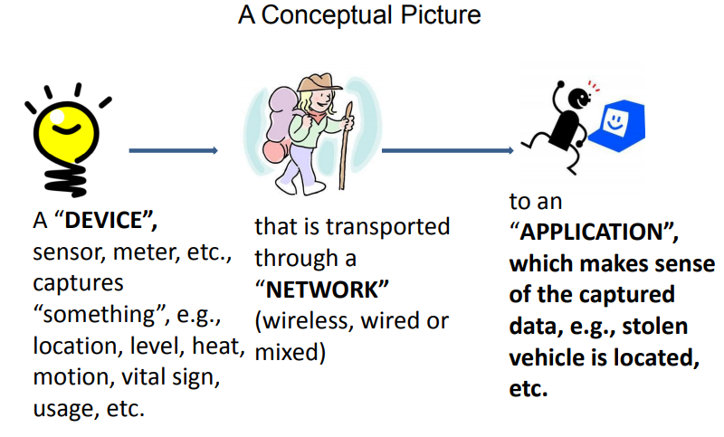
What is M2M?

Slide 41
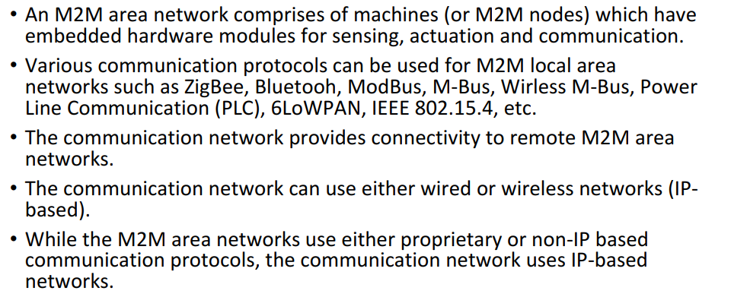

Slide 42
M2M
Machine-to-machine is used to describe any technology that enables networked devices to exchange information and perform actions without the manual assistance of humans.
Artificial intelligence (AI) and machine learning (ML) facilitate the communication between systems, allowing them to make their own autonomous choices.
M2M technology was first adopted in manufacturing and industrial settings helped remotely manage and control data from equipment.
M2M has since found applications in other sectors, such as healthcare, business and insurance. M2M is also the foundation for the internet of things (IoT).
The main purpose of machine-to-machine technology is to tap into sensor data and transmit it to a network.
M2M systems often use public networks and access methods -- for example, cellular or Ethernet -- to make it more cost-effective.
autonomic computing software programmed to help a network device interpret data and make decisions.

Slide 43
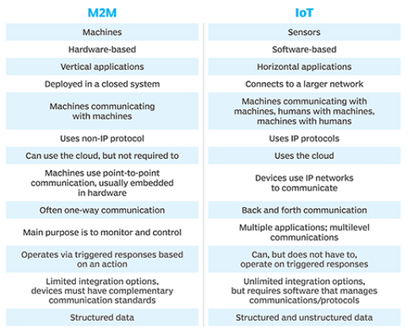

Slide 44
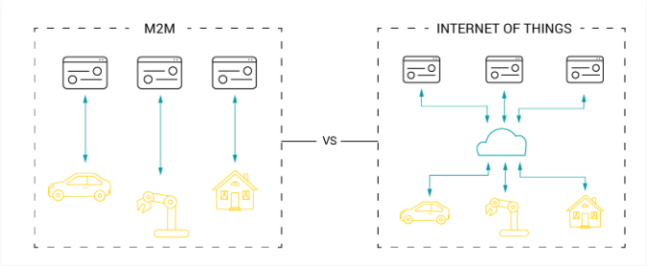

Slide 45
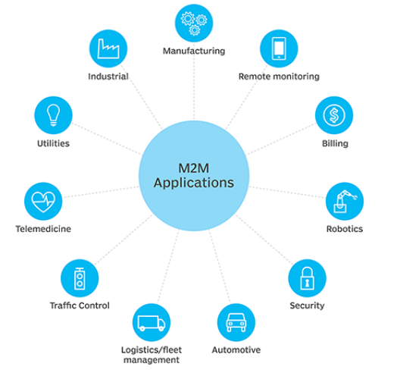
Applications

Slide 46
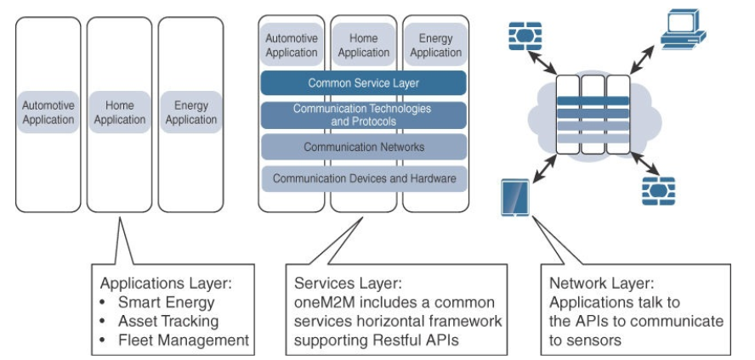
M2M Architecture

Slide 47
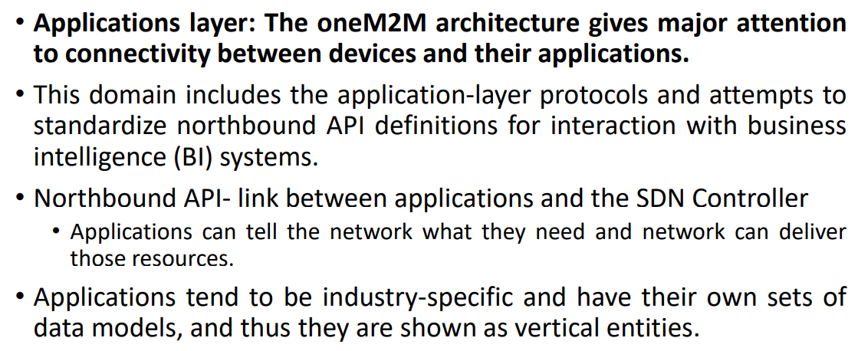
M2M Architecture

Slide 48
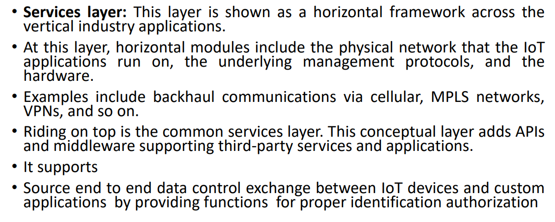
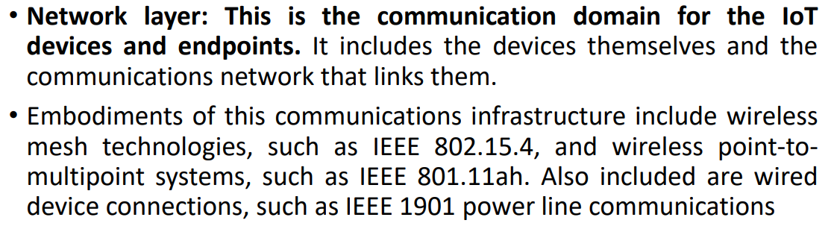

Slide 49
Data Communication
most data communications today happens by way of packets of information travelling over one or more networks.
Networks work together through a common protocol, or a set of rules for transmitting and receiving these packets of data.
Many protocols have been developed.
One of the most widely used is the Transmission Control Protocol/Internet Protocol (TCP/IP).
Generic protocol model used in describing network communications known as the Open System Interconnection (OSI) model is useful for comparing and contrasting different protocols.
It is a general-purpose paradigm for describing how computers communicate with one another over a network.

Slide 50
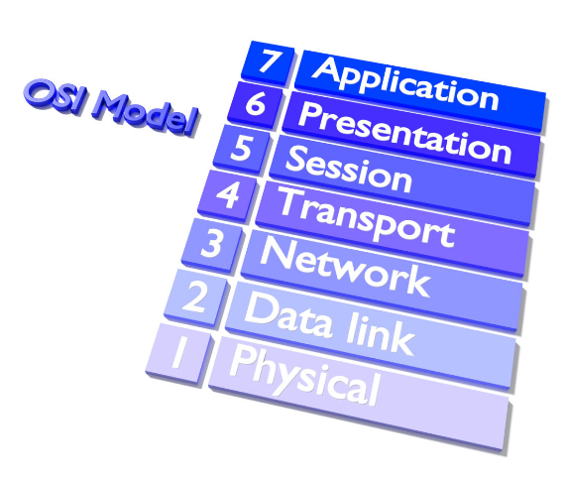
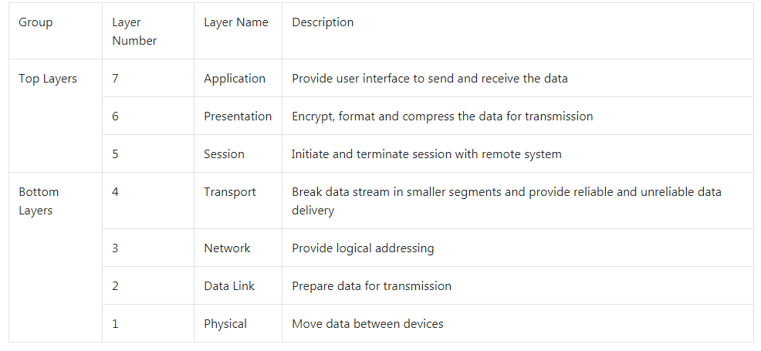
OSI Model

Slide 51

OSI Model

Slide 52

OSI and TCP-IP Model Layers

Slide 53
IOT Network Technologies
LPWAN
Cellular
Bluetooth Low Energy (BLE)
ZigBee
NFC
RFID
Wifi
Ethernet

Slide 54

LPWAN
technologies designed for low-power, long-range wireless communication.
They are ideal for large-scale deployments of low-power IoT devices such as wireless sensors.
LPWAN technologies include LoRa (LongRange physical layer protocol), Haystack, SigFox, LTE-M and NB-IoT (Narrow-Band IoT).
3.5 billion devices by 2021.

Slide 55
Cellular Network
Cellular networks provide the backbone for access the internet, send messages and making connections.
tradeoff between power consumption, range, and bandwidth
2G, 3G, and 4G are different generations of cellular networks but new cellular technologies like Cat-1, LTE-M, and NB-IoT are aimed specifically at IoT applications.
The LPWAN NB-IoT and LTE-M standards address low-power, low-cost IoT communication options using existing cellular networks.
NB-IoT is the newest of these standards and is focused on long-range communication between large numbers of primarily indoor devices.
LTE-M and NB-IoT were developed specifically for IoT, however existing cellular technologies are also frequently adopted for long-range wireless communication.
While this has included 2G (GSM) in legacy devices (and currently being phased out), CDMA (also being retired or phased out), it also includes 3G, which is rapidly being phased out with several network providers retiring all 3G devices. 4G is still active and will be until 5G becomes fully available and implemented.

Slide 56

Bluetooth Low Energy (BLE)
low power wireless communication technology that can be used over a short distance to enable smart devices to communicate
short-range (no more than 100 meters) communication, Low bandwidth – perfect for collecting data from sensor devices
BLE is best suited to devices that transmit low volumes of data in bursts.
Devices are designed to sleep and save power when they are not transmitting data.
Personal IoT devices such as wearable health and fitness trackers, often use BLE. BLE is more energy efficient than ZigBee, Bluetooth classic and Wi-Fi.

Slide 57

ZigBee
ZigBee is a low-power wireless local area network (WLAN) provide small amounts of data using very little power, with most connected devices running off of a battery.
ZigBee operates 2.4GHz wireless communication spectrum.
It has a longer range than BLE by up to 100 meters.
ZigBee is a mesh network protocol. Much depends on their position in the mesh and whether they need to act as routers or controllers within the mesh.
ZigBee designed for building and home automation

Slide 58
Near Field Communication (NFC)
used for very small range communication (up to 4 cm), such as holding an NFC card or tag next to a reader.
NFC is often used for payment systems, but also useful for check-in systems and smart labels in asset tracking .
short range low data rate wireless communication technology operating at 13.56 MHz frequency.
It is a contact less mode of communication using electromagnetic waves.
This technology allows two devices housing NFC chip to communicate for various applications
Data communication between smartphones
Verification of authenticated person having NFC ID card at the office by NFC reader in the door.
Banking payments using NFC compliant credit card to enhance security
Ticket booking at the airports
Automatic running of scheduled features in the NFC phone.

Slide 59
RFID
RFID stands for Radio Frequency Identification.
RFID tags store identifiers and data. The tags are attached to devices and read by an RFID reader.
The typical range of RFID is less than a meter.
RFID tags can be active, passive, or assisted passive.
Passive tags are ideal for devices without batteries, as the ID is passively read by the reader.
Active tags periodically broadcast their ID, while assisted passive tags become active when RFID reader is present.
Dash7 is a communication protocol that uses active RFID that is designed to be used within Industrial IoT applications for secure long-range communication.
Similar to NFC, a typical use case for RFID is tracking inventory items within retail and industrial IoT applications

Slide 60
Wifi
Wifi is standard wireless networking based on IEEE 802.11a/b/g/n specifications.
802.11n offers the highest data throughput, but at the cost of high-power consumption, so IoT devices might only use 802.11b or g for power conservation reasons.
Although wifi is adopted within many prototype and current generation IoT devices, as longer-range and lower-power solutions become more widely available, it is likely that wifi will be superseded by lower-power alternatives.

Slide 61
Ethernet
Widely deployed for wired connectivity within local area networks
Ethernet implements the IEEE 802.3 standard.
Not all IoT devices need to be stationery wireless .
For example, sensor units installed within a building automation system can use wired networking technologies like Ethernet.
Power line communication (PLC), an alternative hard-wired solution, uses existing electrical wiring instead of dedicated network cables

Slide 62
IoT World Forum (IoTWF) Standardized Architecture
In 2014,IoTWF architectural committee (led by Cisco, IBM, Rockwell Automation and others)
includes edge computing, data storage and access.
Using this reference model, we are able to achieve the following
Decompose the IoT problem into smaller parts
Identify different technologies at each layer and how they relate to one another
Define a system in which different parts can be provided by different vendors
Have a process of defining interfaces that leads to interoperability
Define a tiered security model that is enforced at the transition points between levels

Slide 63

IoT World Forum (IoTWF) Standardized Architecture

Slide 64

Level 1 Physical Devices and Controllers
includes the various endpoint devices and sensors that send and receive information .
size of these “things” can range from almost microscopic sensors to giant machines in a factory.

Slide 65

Level 2 Connectivity
focus is on connectivity -reliable and timely transmission of data
transmissions between Layer 1 devices and the network and between the network and information processing that occurs at Layer 3 (the edge computing layer)

Slide 66

Level 3 Edge (Fog) Computing
referred as the “fog” layer
emphasis is on data reduction and converting network data flows into information that is ready for storage and processing by higher layers.

Slide 67

Level 4 Data Accumulation
Converts data and stores, usable for applications when necessary.
Converts event based data to query based processing

Slide 68

Level 5 Data Abstraction
Reconciles multiple data format and ensures consistent semantics from various source.
Confirms data set is complete and consolidate data in one place.

Slide 69

Level 6 Application
Interprets data using software applications.
Applications may monitor, control and provide reports based on the analysis of the data.

Slide 70

Level 7 Collaboration and Processes
Consumes and shares the application information
Communicating IoT information requires multiple steps

Slide 71


Slide 72
A Simplified IoT Architecture
This framework is presented as two parallel stacks:
The IoT Data Management and Compute Stack and the Core IoT Functional Stack.
Reducing the framework down to a pair of three-layer stacks.
Basic model

Slide 73

A Simplified IoT Architecture

Slide 74
A Simplified IoT Architecture
Nearly every IoT model includes core layers similar to those shown on the left side of architecture, including “things,” a communications network, and applications.
The framework presented here separates the core IoT and data management into parallel and aligned stacks.
A simple architecture needs to be expanded on
The network communications layer: needs to consolidate the gateway and backhaul technologies, and ultimately bring the data back to a central location for analysis and processing.
IoT sensors and the many different ways that exist to connect them to a network.

Slide 75
A Simplified IoT Architecture
In IT networks, the applications and analytics layer of IoT doesn’t necessarily exist only in the data center or in the cloud.
Due to the unique challenges and requirements of IoT, it is often necessary to deploy applications and data management throughout the architecture
allowing data collection, analytics, and intelligent controls at multiple points in the IoT system.
In the model presented in figure 2-6, data management is aligned with each of the three layers of the Core IoT Functional Stack.
The three data management layers are the
edge layer (data management within the sensors themselves),
fog layer (data management in the gateways and transit network),
cloud layer (data management in the cloud or central data center).

Slide 76


A Simplified IoT Architecture

Slide 77
A Simplified IoT Architecture
Core IoT Functional Stack can be expanded into sublayers
Network functions:
The communications layer is broken down into four separate sublayers:
the access network,
gateways and backhaul,
IP transport,
operations and management sublayers.
The applications layer of IoT networks
IoT often involves a strong big data analytics component
Thus, the applications layer typically has both analytics and industry-specific IoT control system components
Security is central to the entire architecture, both from network connectivity and data management perspectives

Slide 78
The Core IoT Functional Stack
IoT networks are built around the concept of “things,” or smart objects.
These objects are “smart” because they use a combination of contextual information and configured goals to perform actions.
These actions can be self-contained (that is, the smart object does not rely on external systems for its actions);
however, in most cases, the “thing” interacts with an external system to report information that the smart object collects, to exchange with other objects, or to interact with a management platform.
The management platform can be used to process data collected from the smart object and also guide the behavior of the smart object.

Slide 79
The Core IoT Functional Stack Layer 1: Things: Sensors and Actuators Layer
From an architectural standpoint, the variety of smart object types, shapes, and needs drive the variety of IoT protocols and architectures.
The architectural classification could be:
Battery-powered or power-connected
Mobile or static
Low or high reporting frequency
Simple or rich data
Report range
Object density per cell

Slide 80
The Core IoT Functional Stack Layer 1: Things: Sensors and Actuators Layer
Battery-powered or power-connected:
Based on whether the object carries its own energy supply or receives continuous power from an external power source.
Battery-powered things can be moved more easily than line-powered objects. However, batteries limit the lifetime and amount of energy that the object is allowed to consume, thus driving transmission range and frequency.

Slide 81
The Core IoT Functional Stack Layer 1: Things: Sensors and Actuators Layer
Mobile or static:
“thing” should move or always stay at the same location.
A sensor may be mobile because it is moved from one object to another (for example, a viscosity sensor moved from batch to batch in a chemical plant) or because it is attached to a moving object (for example, a location sensor on moving goods in a warehouse or factory floor).
The frequency of the movement may also vary, from occasional to permanent.
The range of mobility (from a few inches to miles away) often drives the possible power source.

Slide 82
The Core IoT Functional Stack Layer 1: Things: Sensors and Actuators Layer
Low or high reporting frequency:
how often the object should report monitored parameters.
A rust sensor may report values once a month.
A motion sensor may report acceleration several hundred times per second.
Higher frequencies drive higher energy consumption, which may create constraints on the possible power source (and therefore the object mobility) and the transmission range.

Slide 83
The Core IoT Functional Stack Layer 1: Things: Sensors and Actuators Layer
Simple or rich data:
the quantity of data exchanged at each report cycle.
A humidity sensor in a field may report a simple daily index value (on a binary scale from 0 to 255), while an engine sensor may report hundreds of parameters, from temperature to pressure, gas velocity, compression speed, carbon index, and many others.
Richer data typically drives higher power consumption.
This classification is often combined with the previous to determine the object data throughput (low throughput to high throughput).
A medium-throughput object may send simple data at rather high frequency (in which case the flow structure looks continuous), or may send rich data at rather low frequency (in which case the flow structure looks bursty).

Slide 84
The Core IoT Functional Stack Layer 1: Things: Sensors and Actuators Layer
Report range:
the distance at which the gateway is located.
For example, for your fitness band to communicate with your phone, it needs to be located a few meters away at most.
The assumption is that your phone needs to be at visual distance for you to consult the reported data on the phone screen.
If the phone is far away, you typically do not use it, and reporting data from the band to the phone is not necessary.
A moisture sensor in the asphalt of a road may need to communicate with its reader several hundred meters or even kilometers away.

Slide 85
The Core IoT Functional Stack Layer 1: Things: Sensors and Actuators Layer
Object density per cell:
the number of smart objects (with a similar need to communicate) over a given area, connected to the same gateway.
An oil pipeline may utilize a single sensor at key locations every few miles.
telescope at the Whipple Observatory deploy hundreds, and sometimes thousands, of mirrors over a small area, each with multiple gyroscopes, gravity, and vibration sensors.

Slide 86

The Core IoT Functional Stack Layer 1: Things: Sensors and Actuators Layer

Slide 87
The Core IoT Functional Stack Layer 1: Things: Sensors and Actuators Layer
These sensors either need to have a constant source of power (resulting in limited mobility) or need to be easily accessible for battery replacement (resulting in limited transmission range).
A first step in designing an IoT network is to examine the requirements in terms of mobility and data transmission (how much data, how often).
Once determined the influence of the smart object form factor over its transmission capabilities (transmission range, data volume and frequency, sensor density and mobility), then ready to connect the object and communicate.

Slide 88
The Core IoT Functional Stack Layer 2: Communications Network Layer
Access Network Sublayer:
There is a direct relationship between the IoT network technology you choose and the type of connectivity topology this technology allows.
Each technology was designed with a certain number of use cases in mind (what to connect, where to connect, how much data to transport at what interval and over what distance).
These use cases determined the frequency band that was expected to be most suitable, the frame structure matching the expected data pattern (packet size and communication intervals), and the possible topologies that these use cases illustrate.

Slide 89
The Core IoT Functional Stack Layer 2: Communications Network Layer
An access technology will be required.
IoT sometimes reuses existing access technologies
Whereas some access technologies were developed specifically for IoT use cases.

Slide 90

The Core IoT Functional Stack Layer 2: Communications Network Layer

Slide 91
The Core IoT Functional Stack Layer 2: Communications Network Layer
For example,
Cellular is indicated for transmissions beyond 5 km, but you could achieve a successful cellular transmission at shorter range (for example, 100 m).
ZigBee is expected to be efficient over a range of a few tens of meters, but you would not expect a successful ZigBee transmission over a range of 10 km.

Slide 92
The Core IoT Functional Stack Layer 2: Communications Network Layer
Common groups are as follows:
PAN (personal area network): Scale of a few meters. This is the personal space around a person. A common wireless technology for this scale is Bluetooth.
HAN (home area network): Scale of a few tens of meters. At this scale, common wireless technologies for IoT include ZigBee and Bluetooth Low Energy (BLE).
NAN (neighborhood area network): Scale of a few hundreds of meters. The term NAN is often used to refer to a group of house units from which data is collected.

Slide 93
The Core IoT Functional Stack Layer 2: Communications Network Layer
FAN (field area network): Scale of several tens of meters to several hundred meters.
FAN typically refers to an outdoor area larger than a single group of house units.
The FAN is often seen as “open space” (and therefore not secured and not controlled).
A FAN is sometimes viewed as a group of NANs,
FAN can be as a group of HANs or a group of smaller outdoor cells.
As you can see, FAN and NAN may sometimes be used interchangeably.

Slide 94
The Core IoT Functional Stack Layer 2: Communications Network Layer
LAN (local area network):
Scale of up to 100 m.
In the IoT space when standard networking technologies (such as Ethernet or IEEE 802.11) are used.
Other networking classifications, such as MAN (metropolitan area network, with a range of up to a few kilometers) and WAN (wide area network, with a range of more than a few kilometers), are also commonly used.
Similar achievable distances do not mean similar protocols and similar characteristics.
Each protocol uses a specific frame format and transmission technique over a specific frequency (or band).

Slide 95
The Core IoT Functional Stack Layer 2: Communications Network Layer
Some technologies offer flexible connectivity structure to extend communication possibilities:
Point-to-point topologies
Point-to-multipoint topologies

Slide 96
The Core IoT Functional Stack Layer 2: Communications Network Layer
Point-to-point topologies:
These topologies allow one point to communicate with another point. This topology in its strictest sense is uncommon for IoT access, as it would imply that a single object can communicate only with a single gateway.
Point-to-multipoint topologies:
These topologies allow one point to communicate with more than one other point.
Most IoT technologies where one or more than one gateways communicate with multiple smart objects are in this category. However, depending on the features available on each communicating mode, several subtypes need to be considered.

Slide 97


Star and Clustered topologies

Slide 98


Mesh Topology

Slide 99
The Core IoT Functional Stack Layer 2: Communications Network Layer
Gateways and Backhaul Sublayer
Data collected from a smart object may need to be forwarded to a central station where data is processed.
A different location from the smart object, data directly received from the sensor through an access technology needs to be forwarded to another medium (the backhaul) and transported to the central station.
The gateway is in charge of this inter-medium communication.

Slide 100
The Core IoT Functional Stack Layer 2: Communications Network Layer
In most cases, the smart objects are static or mobile within a limited area.
The gateway is often static.
However, some IoT technologies do not apply this model.
For example, dedicated short-range communication (DSRC) allows vehicle-to-vehicle and vehicle-to-infrastructure communication.

Slide 101
The Core IoT Functional Stack Layer 2: Communications Network Layer
Dedicated short-range communication (DSRC)
Smart object’s position relative to the gateway is static.
The car includes sensors and one gateway.
Communication between the sensors and the gateway may involve wired or wireless technologies.
Sensors may also be integrated into the road infrastructure and connect over a wired or wireless technology to a gateway on the side of the road.
A wireless technology (DSRC operates in the upper 5 GHz range) is used for backhaul communication, peer-to-peer, or mesh communication between vehicles.
The range at which DSRC can communicate is limited.

Slide 102

The Core IoT Functional Stack Layer 2: Communications Network Layer

Slide 103
The Core IoT Functional Stack Layer 2: Communications Network Layer
Network Transport Sublayer
In a hierarchical communication architecture in which a series of smart objects report to a gateway that conveys the reported data over another medium and up to a central station.
However, practical implementations are often flexible, with multiple transversal communication paths.
For example, consider the case of IoT for the energy grid. Your house may have a meter that reports the energy consumption to a gateway over a wireless technology.
Other houses in your neighbourhood (NAN) make the same report, likely to one or several gateways.
If your power consumption becomes unusually high, the utility headend application server may need on-demand reporting from your meter at short intervals to follow the consumption trend.
From a standard vertical push model, the transport structure changes and becomes bidirectional (downstream pull model instead of upstream push).

Slide 104
The Core IoT Functional Stack Layer 2: Communications Network Layer
Distribution automation (DA)
Allows meter to communicate with neighbouring meters or other devices in the electrical distribution grid. With such communication, consumption load balancing may be optimized.
For example, if your air conditioning pulses fresh air at regular intervals.

Slide 105
The Core IoT Functional Stack Layer 2: Communications Network Layer
Your smart meter may communicate with your house appliances to evaluate their type and energy demand.
Once the system learns your consumption pattern,
Smart meter may communicate with your house appliances to evaluate their type and energy demand.
system learns your consumption pattern
E.g. public car charging station

Slide 106
The Core IoT Functional Stack Layer 2: Communications Network Layer
Communication structure may include
peer-to-peer (for example, meter to meter), point-to-point (meter to headend station), point-to-multipoint (gateway or head end to multiple meters), unicast and multicast communications (software update to one or multiple systems).
In a multitenant environment (for example, electricity and gas consumption management), different systems may use the same communication pathways.
This communication occurs over multiple media (for example, power lines inside your house or a short-range wireless system like indoor Wi-Fi and/or ZigBee), a longer-range wireless system to the gateway, and yet another wireless or wired medium for backhaul transmission.
Communication structure must include, a network protocol with specific characteristics, Scalability, security, Standard and open protocol, IP protocol .

Slide 107
The Core IoT Functional Stack Layer 2: Communications Network Layer
Transport layer protocols
built above IP (UDP and TCP) can easily be leveraged to decide whether the network should control the data packet delivery (with TCP) or whether the control task should be left to the application (UDP).
UDP is a much lighter and faster protocol than TCP.
However, it does not guarantee packet delivery.
Both TCP and UDP can be secured with TLS/SSL (TCP) or DTLS (UDP).

Slide 108
The Core IoT Functional Stack Layer 2: Communications Network Layer
IoT Network Management Sublayer
IP, TCP, and UDP bring connectivity to IoT networks.
Upper-layer protocols need to take care of data transmission between the smart objects and other systems.
Multiple protocols have been leveraged or created to solve IoT data communication problems.
Some networks rely on a
push model
that is, a sensor reports at a regular interval or based on a local trigger
pull model
that is, an application queries the sensor over the network
Multiple hybrid approaches are also possible.

Slide 109
The Core IoT Functional Stack Layer 2: Communications Network Layer
Web-based protocols
HTTP
WebSocket
Extensible Messaging and Presence Protocol (XMPP)

Slide 110
The Core IoT Functional Stack Layer 2: Communications Network Layer
Some IoT implementers have suggested HTTP for the data transfer phase.
HTTP has a client and server component.
The sensor could use the client part to establish a connection to the IoT central application (the server),
but HTTP is something of a fat protocol and was not designed to operate in constrained environments with low memory, low power, low bandwidth, and a high rate of packet failure.

Slide 111
The Core IoT Functional Stack Layer 2: Communications Network Layer
WebSocket (Small compared to HTTP)
is part of the HTML5 specification, and provides a simple bidirectional connection over a single connection.
WebSocket to manage the connection between the smart object and an external application.
WebSocket is often combined with other protocols, such as MQTT (Message Queue Telemetry Transport ).

Slide 112
The Core IoT Functional Stack Layer 2: Communications Network Layer
Extensible Messaging and Presence Protocol (XMPP)
XMPP is based on instant messaging and presence.
It allows the exchange of data between two or more systems and supports presence and contact list maintenance.
It can also handle publish/subscribe, making it a good choice for distribution of information to multiple devices.
A limitation of XMPP is its reliance on TCP,
which may force subscribers to maintain open sessions to other systems and may be a limitation for memory-constrained objects.

Slide 113
The Core IoT Functional Stack Layer 2: Communications Network Layer
IoT protocol
IETF Constrained Restful Environments (CoRE)
Constrained Application Protocol (CoAP).
MQTT (Message Queue Telemetry Transport)

Slide 114
The Core IoT Functional Stack Layer 2: Communications Network Layer
IETF Constrained Restful Environments (CoRE)
Working group: Constrained Application Protocol (CoAP).
CoAP uses some methods similar to those of HTTP (such as Get, Post, Put, and Delete) but implements a shorter list, thus limiting the size of the header.
CoAP also runs on UDP (whereas HTTP typically uses TCP).
CoAP observation: Observation allows the streaming of state changes as they occur

Slide 115
The Core IoT Functional Stack Layer 2: Communications Network Layer
Message Queue Telemetry Transport (MQTT)
MQTT uses a broker-based architecture.
The sensor can be set to be an MQTT publisher (publishes a piece of information),
the application that needs to receive the information can be set as the MQTT subscriber,
Any intermediary system can be set as a broker to relay the information between the publisher and the subscriber(s).
MQTT runs over TCP.
A consequence of the reliance on TCP is that an MQTT client typically holds a connection open to the broker at all times.
This may be a limiting factor in environments where loss is high or where computing resources are limited.

Slide 116
The Core IoT Functional Stack Layer 3: Applications and Analytics Layer
Analytics Versus Control Applications
Each application collects data and provides a range of functions based on analysing the collected data.
Analytics application:
This type of application collects data from multiple smart objects, processes the collected data, and displays information resulting from the data that was processed.
Control application:
This type of application controls the behavior of the smart object or the behavior of an object related to the smart object.
For example, a pressure sensor may be connected to a pump. A control application increases the pump speed when the connected sensor detects a drop in pressure.

Slide 117
The Core IoT Functional Stack Layer 3: Applications and Analytics Layer
Data Versus Network Analytics
Data analytics:
This type of analytics processes the data collected by smart objects and combines it to provide an intelligent view related to the IoT system.
E.g.
Simple case dashboard can display an alarm when a weight sensor detects that a shelf is empty in a store.
Complex case, temperature, pressure, wind, humidity, and light levels collected from thousands of sensors
Data analytics can also monitor the IoT system itself.
For example, a machine or robot in a factory can report data about its own movements.

Slide 118
The Core IoT Functional Stack Layer 3: Applications and Analytics Layer
Network analytics:
Most IoT systems are built around smart objects connected to the network.
A loss or degradation in connectivity is likely to affect the efficiency of the system.
Such a loss can have dramatic effects.
For example, open mines use wireless networks to automatically pilot dump trucks.
Loss of connectivity means that data stops being fed to your data analytics platform, and the system stops making intelligent analyses of the IoT system.

Slide 119
The Core IoT Functional Stack Layer 3: Applications and Analytics Layer
Data Analytics Versus Business Benefits
Collecting and interpreting the data generated by these devices is where the value of IoT is realized.
Static IoT networks : Cant be update or add/remove sensors
Connect to new sensors.
This enhanced data processing and can add value for businesses.
E.g. Vending machines deployed throughout a city
Sensors can be deployed to report when a machine is in an error state.
A repair person can be sent to address.
This type of alert is a time saver

Slide 120
The Core IoT Functional Stack Layer 3: Applications and Analytics Layer
Smart Services:
Smart services use IoT and aim for efficiency.
Smart services can also be used to measure the efficiency of machines by detecting machine output, speed, or other forms of usage evaluation.
Entire operations can be optimized with IoT.
Smart services can be integrated into an IoT system.
For example, sensors can be integrated in a light bulb.
Similar efficiency can be extended to larger systems than a house.
For example, smart grid

Slide 121

IoT Data Management and Compute Stack

Slide 122
IoT Data Management and Compute Stack: Fog Computing
Distribute data management throughout the IoT system, as close to the edge of the IP network as possible.
The best-known embodiment of edge services in IoT is fog computing.
Just as clouds exist in the sky, fog rests near the ground. In the same way, the intention of fog computing is to place resources as close to the ground that is, the IoT devices as possible.
Any device with computing, storage, and network connectivity can be a fog node.
Examples include industrial controllers, switches, routers, embedded servers, and IoT gateways.
Analyzing IoT data close to where it is collected minimizes latency, offloads gigabytes of network traffic from the core network, and keeps sensitive data inside the local network.

Slide 123

IoT Data Management and Compute Stack: Fog Computing

Slide 124
IoT Data Management and Compute Stack: Fog Computing
Fog services are typically accomplished very close to the edge device, sitting as close to the IoT endpoints as possible.
One significant advantage of this is that the fog node has contextual awareness of the sensors it is managing because of its geographic proximity to those sensors.
monitoring all the sensor activity
analyze information from all the sensors
to send back only the relevant information over the backhaul network to the cloud
volume of data sent upstream is greatly reduced

Slide 125
IoT Data Management and Compute Stack: Fog Computing
The fog layer thus provides a distributed edge control loop capability, where devices can be monitored, controlled, and analyzed in real time without the need to wait for communication from the central analytics and application servers in the cloud.

Slide 126
IoT Data Management and Compute Stack: Fog Computing
For example,
tire pressure sensors on a large truck in an open-pit mine might continually report measurements all day long.
There may be only minor pressure changes that are well within tolerance limits, making continual reporting to the cloud unnecessary.
Is it really useful to continually send such data back to the cloud over a potentially expensive backhaul connection?
With a fog node on the truck, it is possible to not only measure the pressure of all tires at once but also combine this data with information coming from other sensors in the engine, hydraulics, and so on.
With this approach, the fog node sends alert data upstream only if an actual problem is beginning to occur on the truck that affects operational efficiency.

Slide 127
IoT Data Management and Compute Stack: Fog Computing
IoT fog computing enables data to be preprocessed and correlated with other inputs to produce relevant information.
This data can then be used as real-time, actionable knowledge by IoT-enabled applications.
Longer term, this data can understanding of network behavior and systems for the purpose of developing proactive policies, processes, and responses.
Fog applications and the Internet of Things have in common is data reduction monitoring or analyzing real-time data from network connected things and then initiating an action

Slide 128
IoT Data Management and Compute Stack: Fog Computing
Characteristic of fog computing are as follows:
Contextual location awareness and low latency: The fog node sits as close to the IoT endpoint as possible to deliver distributed computing.
Geographic distribution: In sharp contrast to the more centralized cloud, the services and applications targeted by the fog nodes demand widely distributed deployments.
Deployment near IoT endpoints: Fog nodes are typically deployed in the presence of a large number of IoT endpoints. For example, typical metering deployments often see 3000 to 4000 nodes per gateway router, which also functions as the fog computing node.
Wireless communication between the fog and the IoT endpoint: Although it is possible to connect wired nodes, the advantages of fog are greatest when dealing with a large number of endpoints, and wireless access is the easiest way to achieve such scale.
Use for real-time interactions: Important fog applications involve real-time interactions rather than batch processing. Preprocessing of data in the fog nodes allows upper-layer applications to perform batch processing on a subset of the data.

Slide 129
IoT Data Management and Compute Stack: Edge Computing
Edge computing is also sometimes called “mist” computing.
clouds exist in the sky, and
fog sits near the ground, then
mist is what actually sits on the ground.
Thus, the concept of mist is to extend fog to the furthest point possible, right into the IoT endpoint device itself.

Slide 130
IoT Data Management and Compute Stack: The Hierarchy of Edge, Fog, and Cloud
Edge or fog computing in no way replaces the cloud.
Rather, they complement each other, and many use cases actually require strong cooperation between layers.
Edge and fog computing layers simply act as a filtering, analyzing, and otherwise managing data endpoints.
This saves the cloud from being queried by each and every node for each event.

Slide 131
IoT Data Management and Compute Stack: The Hierarchy of Edge, Fog, and Cloud
At each stage, data is collected, analyzed, and responded to when necessary.
As data to be sent to the cloud, the latency becomes higher.
The advantage of this hierarchy is that a response to events from resources close to the end device is fast and can result in immediate benefits,
While still having deeper compute resources available in the cloud when necessary.

Slide 132
IoT Data Management and Compute Stack: The Hierarchy of Edge, Fog, and Cloud
It is important to note that the heterogeneity of IoT devices also means a heterogeneity of edge and fog computing resources.
Different operating systems, have different CPU and data storage capabilities, and have different energy consumption profiles
While cloud resources are expected to be homogenous
Common communications services framework between Edge, Fog and Cloud

Slide 133

IoT Data Management and Compute Stack: The Hierarchy of Edge, Fog, and Cloud

Slide 134
IoT Data Management and Compute Stack: The Hierarchy of Edge, Fog, and Cloud
The fog IoT application then directs different types of data to the optimal place for analysis:
The most time-sensitive data is analyzed on the edge or fog node closest to the things generating the data.
Data that can wait seconds or minutes for action is passed along to an aggregation node for analysis and action.
Data that is less time sensitive is sent to the cloud for historical analysis, big data analytics, and long-term storage.
For example, each of thousands or hundreds of thousands of fog nodes might send periodic summaries of data to the cloud for historical analysis and storage.

Slide 135
IoT Data Management and Compute Stack: The Hierarchy of Edge, Fog, and Cloud
Based on amount of data you can decide whether cloud computing is enough or whether edge or fog computing would improve your system efficiency.
It avoids the need for costly bandwidth additions by offloading gigabytes of network traffic from the core network.

Slide 136


Functional blocks of an IoT ecosystem

Slide 137
Sensors
It senses
measures some physical quantity and converts that measurement reading into a digital representation
digital representation is passed to another device for transformation into useful data that can be consumed by intelligent devices or humans.
provide an extremely wide spectrum of rich and diverse measurement data with far greater precision than human senses
Sensors can be readily embedded in any physical objects that are easily connected to the Internet by wired or wireless networks
Because these connected host physical objects with multidimensional sensing capabilities communicate with each other and external systems, they can interpret their environment and make intelligent decisions

Slide 138

Types

Slide 139

Contd..

Slide 140



Slide 141

Contd..

Slide 142
Contd..
Sensors come in all shapes and sizes
can measure all types of physical conditions
uses a variety of technical advances to improve the efficiency, sustainability, and profitability of traditional farming practices.
the use of GPS and satellite aerial imagery for determining field viability;
robots for high-precision planting, harvesting, irrigation, and so on; and
real-time analytics and artificial intelligence to predict optimal crop yield, weather impacts, and soil quality.
North Dakota State University (NDSU), can be planted directly in the soil and left in the ground to biodegrade without any harm to soil quality.

Slide 143


Contd..

Slide 144

Contd..

Slide 145
Actuators
sensors are designed to sense and measure practically any measurable variable in the physical world.
They convert electric signals or digital representations that can be consumed by an intelligent agent (a device or a human).
electric signals sent to some type of microprocessor or microcontroller for additional processing.
The human brain signals motor function and movement, and the nervous system carries that information to the appropriate part of the muscular system.
Actuators receive control signal (commonly an electric signal or digital command) that triggers a physical effect, usually some type of motion, force, and so on.
Correspondingly, a processor can send an electric signal to an actuator that translates the signal into some type of movement (linear, rotational, and so on) or useful work that changes or has a measurable impact on the physical world.
This interaction between sensors, actuators, and processors is the basis for various technical fields, including robotics and biometrics.

Slide 146

Contd..

Slide 147

Contd..

Slide 148



Slide 149
Example
precision agriculture example demonstrate how actuators can complement and enhance a sensor-only solution.
For example, the smart sensors used to evaluate soil quality (by measuring a variety of soil, temperature, and plant characteristics)
connected with electrically or pneumatically controlled valve actuators that control water, pesticides, fertilizers, herbicides, and so on.
Intelligently triggering a high-precision actuator based on well-defined sensor readings of temperature, pH, soil/air humidity, nutrient levels, and so on to deliver a highly optimized and custom environment-specific solution is truly smart farming

Slide 150
Micro-Electro-Mechanical Systems (MEMS)
One of the most interesting advances in sensor and actuator technologies is in how they are packaged and deployed.
Micro-electro-mechanical systems (MEMS), is micro-machines, can integrate and combine electric and mechanical elements, such as sensors and actuators, on a very small (millimeter or less) scale.
One of the keys to this technology is a micro fabrication technique that is similar to what is used for microelectronic integrated circuits.
This approach allows mass production at very low costs. The combination of tiny size, low cost, and the ability to mass produce makes MEMS an attractive option for a huge number of IoT applications.
MEMS devices have already been widely used in a variety of different applications and can be found in very familiar everyday devices.
For example, inkjet printers use micropump MEMS.
Smart phones also use MEMS technologies for things like accelerometers and gyroscopes.
automobiles were among the first to commercially introduce MEMS into the mass market, with airbag accelerometers.

Slide 151
Smart Objects
Smart objects are, quite simply, the building blocks of IoT.
They transform everyday objects into a network of intelligent objects that are able to learn from and interact with their environment in a meaningful way.
If a sensor is a standalone device that simply measures the humidity of the soil.
If that same sensor is connected as part of an intelligent network that is able to coordinate intelligently with actuators to trigger irrigation systems as needed based on those sensor readings
Extending that even further, imagine that the coordinated sensor/actuator set is intelligently interconnected with other sensor/actuator sets to further coordinate fertilization, pest control, and so on—and even communicate with an intelligent backend to calculate crop yield potential.
This now starts to look like a complete system and provides the intelligent automation .
smart sensor, smart device, IoT device, intelligent device, thing, smart thing, intelligent node, intelligent thing, ubiquitous thing, and intelligent product

Slide 152
Smart Objects: A Definition
Sensor(s) and/or actuator(s):
capable of interacting with the physical.
Sensor learns and measures its environment, whereas an actuator is able to produce some change in the physical world.
No need to contain both sensors and actuators.
Smart object can contain one or multiple sensors and/or actuators, depending upon the application.
Processing unit:
Acquiring data, processing and analyzing sensing information received by the sensor(s), coordinating control signals to any actuators, and controlling a variety of functions on the smart object, including the communication and power systems.
microcontroller because of its small form factor, flexibility, programming simplicity, ubiquity, low power consumption, and low cost.

Slide 153
Smart Objects
Communication device:
responsible for connecting a smart object with other smart objects and the outside world (via the network).
Communication devices for smart objects can be either wired or wireless.
IoT networks smart objects are wirelessly interconnected since low cost, limited infrastructure availability, and ease of deployment.
Power source:
Smart objects have components that need to be powered.
power requirements also vary greatly from application to application.
smart object relies on battery power, implies that power efficiency, judicious power management, sleep modes, ultra-low power consumption hardware, and so on are critical design elements.
For long-term, power is commonly obtained from scavenger sources (solar, piezoelectric, and so on) or is obtained in a hybridized manner.

Slide 154

Contd..

Slide 155
Trends in Smart Objects
Size is decreasing:
in reference to MEMS, there is a clear trend of ever-decreasing size.
Some smart objects are so small they are not even visible to the naked eye.
This reduced size makes smart objects easier to embed in everyday objects.
Power consumption is decreasing:
hardware components of a smart object continually consume less power.
Some sensors are passive. Some battery-powered sensors last 10 or more years without battery replacement.
Processing power is increasing:
Processors are more powerful and smaller as they become increasingly complex and connected.
Communication capabilities are improving:
It’s no big surprise that wireless speeds are continually increasing, but they are also increasing in range.
IoT is driving the development of more and more specialized communication protocols covering a greater diversity of use cases and environments.
Communication is being increasingly standardized:
open standards for IoT communication protocols.
Improved communication between interconnected smart objects within a system and between that system and external entities(for example, edge compute, cloud).

Slide 156
Sensor Networks
sensor/actuator network (SANET), is a network of sensors that sense and measure their environment and/or actuators that act on their environment.
sensors and/or actuators are capable of communicating and cooperating in a productive manner.
Effective and well-coordinated communication and cooperation is a prominent challenge.
Smart homes are a type of SANET that display this coordination between distributed sensors and actuators.
For example, smart homes can have temperature sensors that are strategically networked with heating, ventilation, and air-conditioning (HVAC) actuators. When a sensor detects a specified temperature, this can trigger an actuator to take action and heat or cool the home as needed.
Advantages: Greater deployment flexibility (especially in extreme environments or hard-to-reach places) Simpler scaling to a large number of nodes Lower implementation costs Easier long-term maintenance Effortless introduction of new sensor/actuator nodes Better equipped to handle dynamic/rapid topology changes
Disadvantages: Potentially less secure (for example, hijacked access points) Typically lower transmission speeds Greater level of impact/influence by environment

Slide 157
Connecting Smart Objects
IoT devices and sensors must be connected to the network for their data to be utilized.
wide range of sensors, actuators, and smart objects that make up IoT, also protocols used to connect them.
Range: signal propagation and distance.
Frequency Bands: licensed and unlicensed spectrum, sub-GHz frequencies.
Power Consumption: devices connected to a stable power source compared to those that are battery powered.
Topology: various layouts that may be supported for connecting multiple smart objects.
Constrained Devices: limitations of certain smart objects from a connectivity perspective.
Constrained-Node Networks: challenges that are often encountered with networks connecting smart objects.

Slide 158

Range

Slide 159
Frequency Bands
International Telecommunication Union (ITU) and the Federal Communications Commission (FCC) define the regulations and transmission requirements for various frequency bands.
portions of the spectrum are allocated to types of telecommunications such as radio, television, military, and so on
IoT access technologies, the frequency bands are split between licensed and unlicensed bands.
Licensed spectrum applicable to IoT long-range access technologies and allocated to communications infrastructures deployed by services providers, public services, broadcasters, and utilities.
unlicensed spectrum for the industrial, scientific, and medical (ISM) portions of the for short-range devices (SRDs).
Unlicensed means that no guarantees or protections are offered in the ISM bands for device communications.
For IoT access, well-known ISM bands: 2.4 GHz band as used by IEEE 802.11b/g/n Wi-Fi IEEE 802.15.1 Bluetooth IEEE 802.15.4 WPAN

Slide 160
Power Consumption
clear delineation between powered nodes and battery-powered nodes.
A powered node has a direct connection to a power source
Battery-powered nodes bring much more flexibility to IoT devices.
nodes are often classified by the required lifetimes of their batteries.
Does a node need 10 to 15 years of battery life, such as on water or gas meters?
Or is a 5- to 7-year battery life sufficient for devices such as smart parking sensors?
Their batteries can be changed or the devices replaced when a street gets resurfaced.
For devices under regular maintenance, a battery life of 2 to 3 years is an option.
IoT wireless access technologies must address the needs of low power consumption and connectivity for battery-powered nodes. This has led to the evolution of a new wireless environment known as Low-Power Wide-Area (LPWA).

Slide 161

Topology

Slide 162
Contd...
For long-range and short-range technologies, a star topology is prevalent, as seen with cellular, LPWA, and Bluetooth networks.
Star topologies utilize a single central base station or controller to allow communications with endpoints.
For medium-range technologies, a star, peer-to-peer, or mesh topology is common
Peer-to-peer topologies allow any device to communicate with any other device as long as they are in range of each other.
For example, indoor Wi-Fi deployments are mostly a set of nodes forming a star topology around their access points (APs).
outdoor Wi-Fi may consist of a mesh topology for the backbone of APs, with nodes connecting to the APs in a star topology.
IEEE 802.15.4 and 802.15.4g and even wired IEEE 1901.2a PLC are generally deployed as a mesh topology.
A mesh topology helps cope with low transmit power, searching to reach a greater overall distance, and coverage by having intermediate nodes relaying traffic for other nodes. Mesh topology requires the implementation of a Layer 2 forwarding protocol known as mesh-under or a Layer 3 forwarding protocol referred to as mesh-over on each intermediate node.
A node that doesn’t interconnect or relay the traffic of other nodes is known as a leaf node, or reduced-function device (RFD).

Slide 163
Constrained Devices
The Internet Engineering Task Force (IETF) acknowledges in
RFC 7228 that different categories of IoT devices are deployed.
computing, memory, storage, power, and networking continuously evolving and improving, RFC 7228 gives some definitions of constrained nodes.
differentiate constrained nodes from unconstrained nodes, such as servers, desktop or laptop computers, and powerful mobile devices such as smart phones.
Constrained nodes have limited resources that impact their networking feature set and capabilities.
According to RFC 7228, constrained nodes can be broken down into the classes.

Slide 164

Contd...

Slide 165
Constrained-Node Networks
While several of the IoT access technologies, such as Wi-Fi and cellular, are applicable to laptops, smart phones, and some IoT devices, some IoT access technologies are more suited to specifically connect constrained nodes.
Typical examples are IEEE 802.15.4 and 802.15.4g RF, IEEE 1901.2a PLC, LPWA, and IEEE 802.11ah access technologies.
Constrained-node networks are often referred to as low-power and lossy networks (LLNs).
Low-power in the context of LLNs refers to the fact that nodes are battery-powered constrained nodes. Lossy networks indicates that network performance may suffer from interference and variability due to harsh radio environments.
Layer 1 and Layer 2 protocols that can be used for constrained-node networks

Slide 166
Data Rate and Throughput
The data rates available from IoT access technologies range from 100 bps with protocols such as Sigfox to tens of megabits per second with technologies such as LTE and IEEE 802.11ac.
However, the actual throughput is less—sometimes much less—than the data rate.
understanding the bandwidth requirements of a particular technology, its applicability to given use cases, the capacity planning rules, and the expected real throughput are important for proper network design and successful production deployment.
The IoT access technologies developed for constrained nodes are optimized for low power consumption, but they are also limited in terms of data rate, which depends on the selected frequency band, and throughput.

Slide 167
Latency and Determinism
Same throughput, latency expectations of IoT applications should be known when selecting an access technology.
true for wireless networks, where packet loss and retransmissions due to interference, collisions, and noise are normal behaviors.
On constrained networks, latency may range from a few milliseconds to seconds

Slide 168
Overhead and Payload
When considering constrained access network technologies, MAC payload size characteristics required by applications.
minimum IPv6 size is expected to be 1280 bytes.
fragmentation of the IPv6 payload has to be taken into account by link layer access protocols.

